Slide 1
Introduction of this course
Qingyao Wu 吴庆耀
qyw@scut.edu.cn

Slide 2
Policy
Notes:
待處理:
放 cieba
幫忙組隊

Slide 3
QQ group ID: 201567683 The performance of the theory courses and the experiment course : 70% Final Test: 30% https://pan.baidu.com/s/1_DNufMhtUGXD3hYv4kSwoA 密码: cwwx

Slide 4
How do we learn this course
Andrew Ng Deep Learning video (45 minutes)
Given a list of Questions
Group discuss this questions after watch the vedio (20 minutes, each group 10 people)
Answer the questions (15 minutes)
Experiment courses (B7-238)

Slide 5
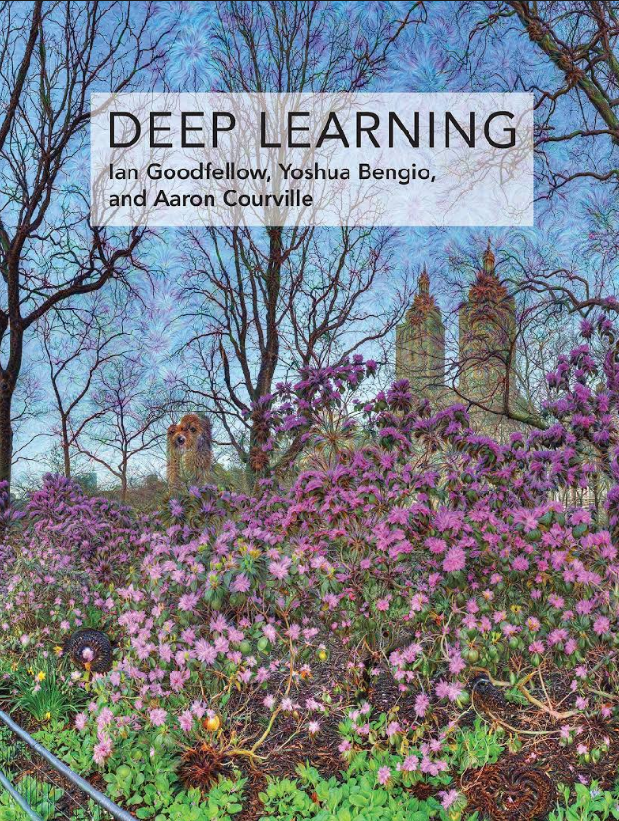
Reference resources
李宏毅 Deep Learning，Machine Learning course
http://speech.ee.ntu.edu.tw/~tlkagk/courses.html
Ian Goodfellow
Yoshua Bengio
Deep Learning Book

Slide 6
Course Contents
Course 1 Neural Networks and Deep Learning
Course 2 Improving deep neural networks hyperparameter
Course 3 Structuring Machine Learning Projects
Course 4 Convolutional Neural Networks
Course 5 Sequence Models

Slide 7
Course 1.1 Question
Q1: What is a neural network?
Q2: What is supervised learning?
Q3: Which NN we would use in the online advertising problem, photo tagging problem and machine translation problem respectively?
Q4: Give some examples about unstructured data.
Q5: Why we use ReLU function instead of Sigmoid function for activation?

Slide 8
Q1: What is a neural network?

Slide 9
Q1: What is a neural network?
A1: A powerful learning algorithm inspired by how the brain works. A neural network is a series of functions takes inputs and give output result.

Slide 10
Q2: What is supervised learning?

Slide 11
Q2: What is supervised learning?
A2: Using labeled samples as training sets to build a mathematical model, and then using the established model to predict unknown samples.

Slide 12
Q3: Which NN we would use in the online advertising problem, photo tagging problem and machine translation problem respectively?

Slide 13
Q3: Which NN we would use in the online advertising problem, photo tagging problem and machine translation problem respectively?
A3: Standard NN, convolutional NN (CNN) and recurrent NN (RNN).

Slide 14
Q4: Give some examples about unstructured data.

Slide 15
Q4: Give some examples about unstructured data.
A4: Image, audio, text and so on.

Slide 16
Q5: Why we use ReLU function instead of Sigmoid function for activation?

Slide 17
Q5: Why we use ReLU function instead of Sigmoid function for activation?
A5: ReLU has lower computation and make outputs sparse.
1. The derivative computation cost of sigmoid and tanh functions are relatively large. The cost of ReLU activation function is much less (1 or 0).
2. When the sigmoid function approaches the saturation region, the derivative tends to zero and cause a slow convergence speed.
3. ReLU makes the output of some neurons become zero, which results in the sparsity of the network and alleviates the overfitting problem.

Slide 18
Thanks

